Slide 1


HOSPITAL EFFICIENCY & FINANCIAL HEALTH ANALYSIS
NZUBECHI CALEB
25 - 10 - 25

Slide 2
Table Of Contents
01.
Our dataset captures how hospital today operate while balancing the clinical care, cost management and operational efficiency , this takes into account admission type to discharge timing and how it affect both patient outcomes and financials
02.
However as the need of healthcare rises, hospital faces peculiar challenges: i) Cost are increasing faster than reimbursement rates. ii) Outcome variability across conditions and admission types make efficiency difficult to sustain. Without visibility into the relationship between length of stay, cost and outcomes , performance optimization becomes guesswork.
03.
How we can use data to understand; i) Which conditions or admission types drive longer stays and higher cost ? ii) How billing and insurance coverage align with operational efficiency iii) How discharge outcomes are affected

Slide 3
OBJECTIVES
Big Idea
The hospital’s financial strength and operational efficiency hinge on how well it balances, long high-revenue elective stays with faster emergency cases

Slide 4
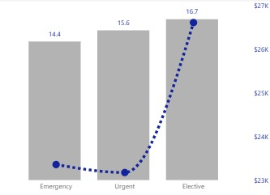
LONGER STAYS DRIVE REVENUE: ELECTIVE ADMISSION GENERATE SIGNIFICANT REVENUE.
Average Length Of Stay
Average Length Of Stay
Admission Type

Slide 5
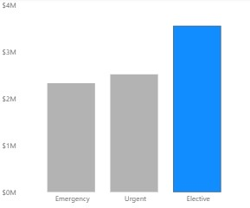
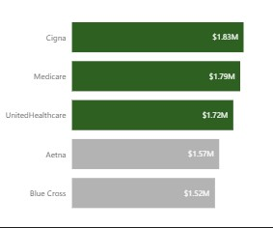
ELECTIVE PRODURES: A KEY DRIVER OF HOSPITAL REVENUE, LARGELY SUPPORTED BY CIGNA, MEDICARE, AND UNITED HEALTHCARE
A Significant Proportion Of Hospital Admission Are Elective, Driving Revenue
Cigna, Medicare, And United Healthcare: Key Payers Supporting Elective Procedure Related Cost And Revenue
Total Amount
Insurance Payer
Admission Type
Total Amount

Slide 6
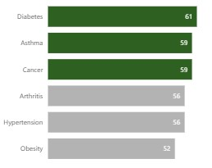
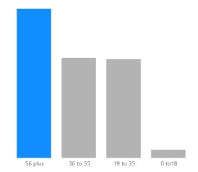
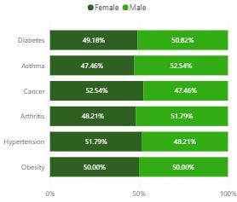
COMORBIDITY, AGE AND GENDER ON HOSPITAL WORKLOAD
The Burden Of Chronic Conditions: Diabetes, Cancer And Asthma had the most impact
Patients aging 56 and above had the highest total sum length of stay among other age groups
Gender distribution is equally balanced across conditions, with male slightly dominating in both diabetes and asthma while the female leading in cancer.
Medical Conditions
Sun of Length of stay
Medical Conditions
Total Patient
Age Group
Total Patient

Slide 7
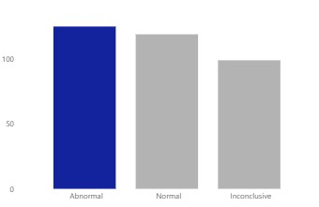
ABNORMAL RESULT HIGHLIGHTS ONGOING DISEASES BURNDEN AND CARE GAPS
Over One-third of patients show uncontrolled or active conditions
125(36.4%)
119(34.7%)

Slide 8
Recommendation
Optimize Elective Admission Throughput.
Elective cases are profitable but resource intensive. Theirs is need to introduce enhanced recovery protocols and preoperative optimization, this can shorten length of stay while maintaining care quality
Enhance Emergency Care Efficiency.
Emergency admission are vital for hospital reputation and patient safety. By using Data driven triage and Rapid Assessment Units, this can reduce congestion and lower the cost per emergency episode.
Insurance and Cost Strategy.
To reduce concentration risk, there is need explore value based reimbursement models and outcome-linked insurance agreements , encouraging shared accountability between hospital and insurer
Predictive Analytics for Risk Management
Use demographics and diagnostic data to build predictive model for abnormal out comes , allowing proactive intervention and better bed management

Slide 9
APPENDIX

Slide 10
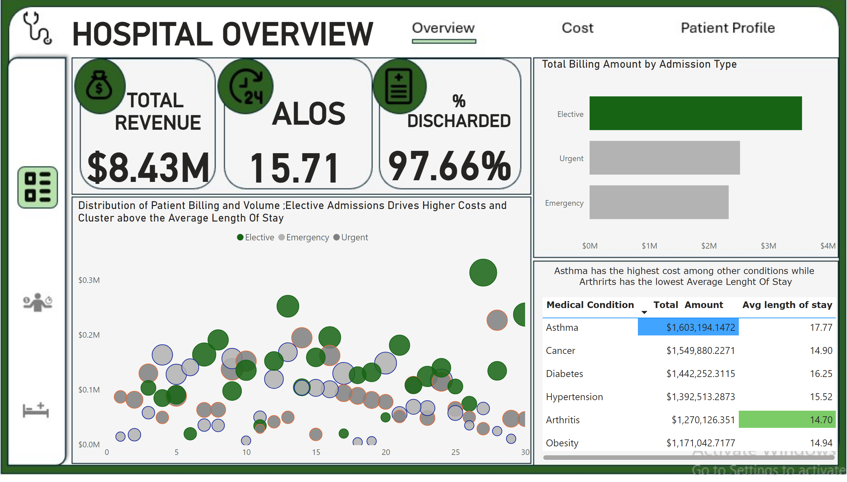
Overview
Notes:
card
No alt text provided
card
No alt text provided
card
No alt text provided
card
No alt text provided
card
No alt text provided
card
No alt text provided
tableEx
No alt text provided
barChart
No alt text provided
Distribution of Patient Billing and Volume ;Elective Admissions Drives Higher Costs and Cluster above the Average Length Of Stay
No alt text provided
card
No alt text provided
card
No alt text provided

Slide 11
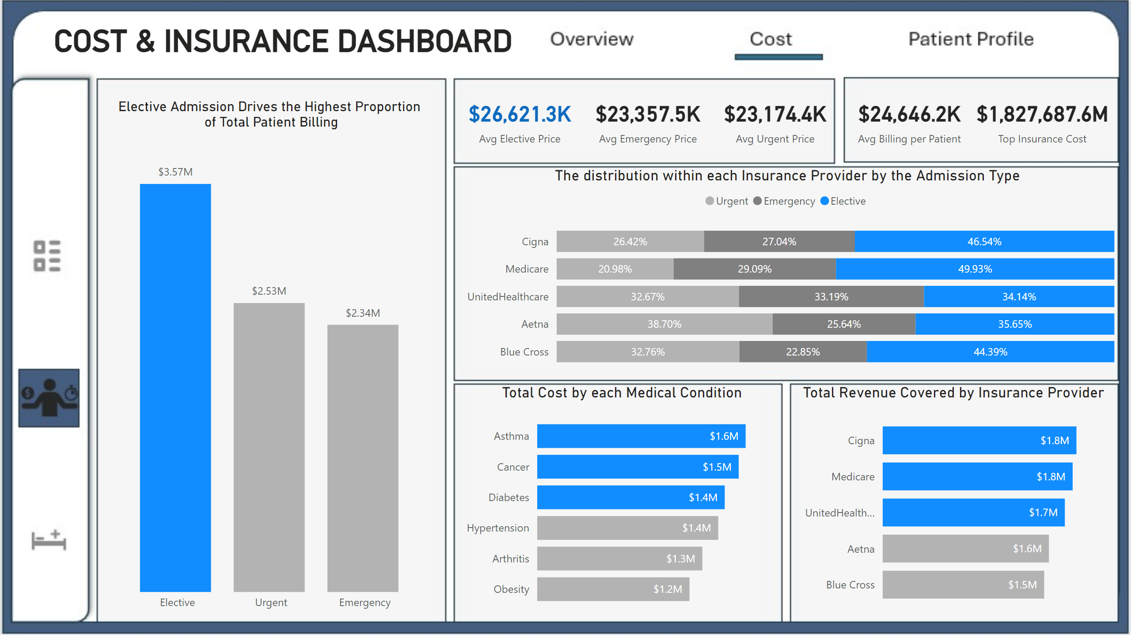
Cost and Insurance
Notes:
card
No alt text provided
card
No alt text provided
card
No alt text provided
card
No alt text provided
card
No alt text provided
card
No alt text provided
card
No alt text provided
Total Revenue Covered by Insurance Provider
No alt text provided
Total Cost by each Medical Condition
No alt text provided
The distribution within each Insurance Provider by the Admission Type
No alt text provided
clusteredColumnChart
No alt text provided

Slide 12
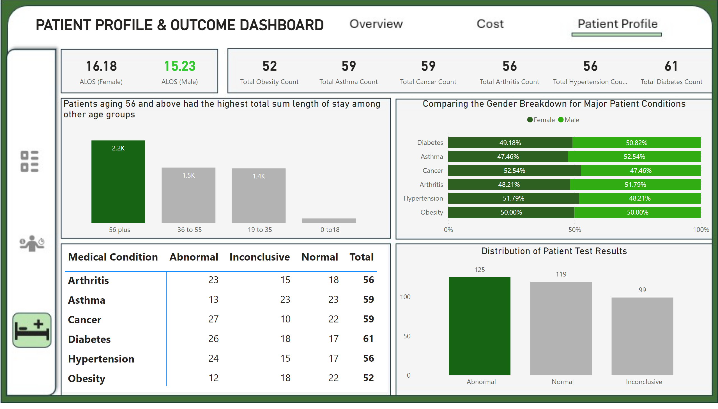
Patient Profile
Notes:
card
No alt text provided
pivotTable
No alt text provided
Patients aging 56 and above had the highest total sum length of stay among other age groups
No alt text provided
Distribution of Patient Test Results
No alt text provided
Comparing the Gender Breakdown for Major Patient Conditions
No alt text provided
card
No alt text provided
card
No alt text provided
card
No alt text provided
card
No alt text provided
card
No alt text provided
card
No alt text provided
card
No alt text provided
card
No alt text provided

